Slide 1
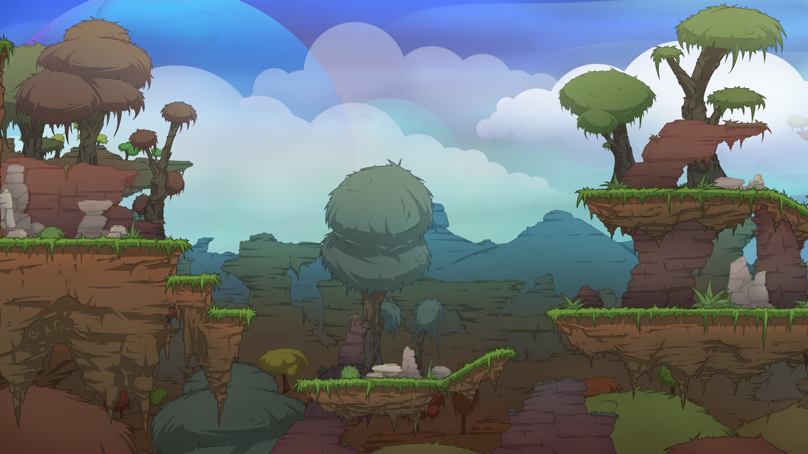
WEEK 8
TILEMAPS, PLAYER SETUP
& LEVEL DESIGN
Game Development Course — Building Worlds with Unity 2D

Slide 2
OVERVIEW
What We Will Cover
01
02
Lecture 15 — Tilemaps & Tiles
Lecture 16 — Player & Level Setup
■ What are Tilemaps?
■ The Tilemap System Architecture
■ Tile Palette & Painting
■ Working with Tiles
■ Rule Tiles — Smart Tiling
■ Animated Tiles
■ Combining Rules & Animation
■ Player Physics (Rigidbody2D)
■ Input System
■ Canvases & UI Components
■ Level Setup & Design

Slide 3
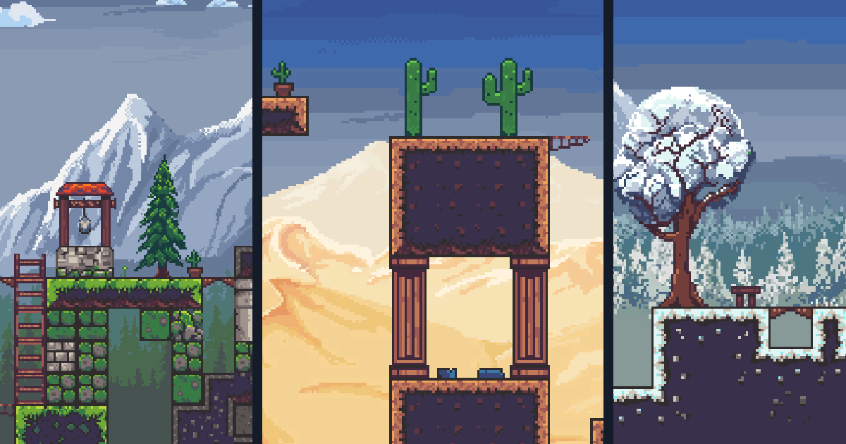
01
LECTURE 15
Tilemaps, Tile Palette, Rule Tiles & Animated Tiles
■ Introduction to Tilemaps ■ Tile Palette
■ Rule Tiles ■ Animated Tiles

Slide 4
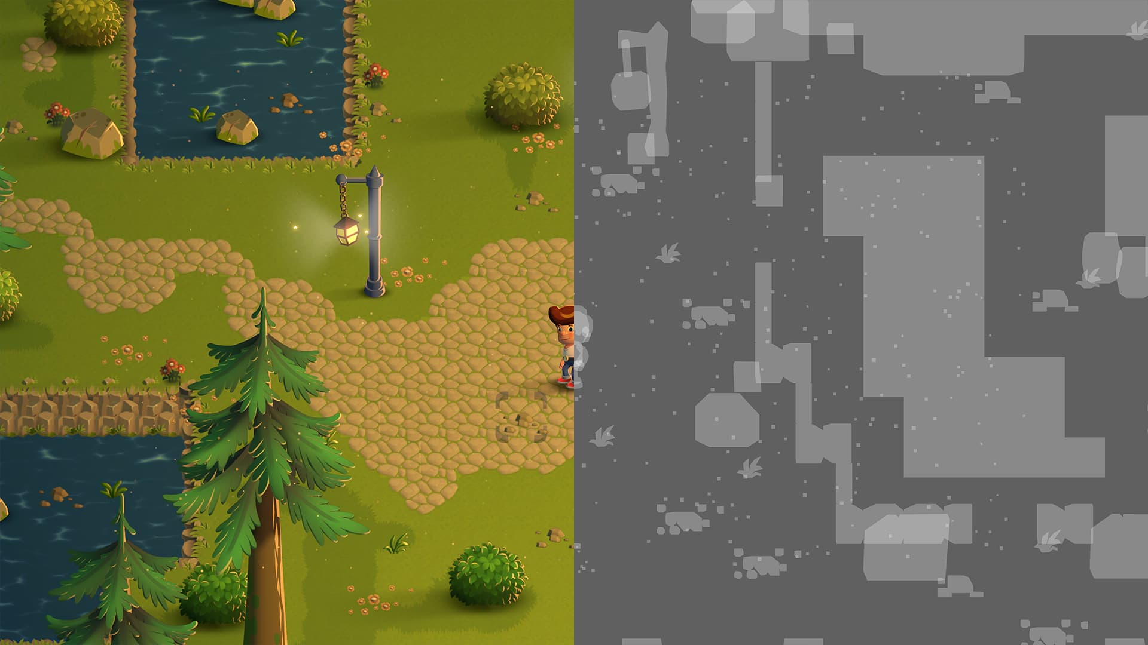
WEEK 8
What Are Tilemaps?
Tilemaps are a 2D level design system in Unity that lets you build game worlds by placing tiles on a grid — an efficient, visual way to construct levels.
Grid-based placement for precision
Auto-batching for performance
Layering for complex scenes
2D Physics integration
Tilemaps are the foundation of most 2D games — from platformers to RPGs to strategy games.
04

Slide 5
WEEK 8
The Tilemap System Architecture
Five interconnected components work together to render and manage your 2D levels.
Grid
Tilemap
Tile Asset
The parent container defining the coordinate system — supports rectangular, isometric, or hexagonal layouts.
The layer that holds and renders tiles. Multiple Tilemaps can exist under one Grid for parallax and depth.
Data object containing sprite references, collision info, and custom behavior for each tile type.
Tilemap Renderer
Tilemap Collider 2D
Handles how tiles are drawn to the screen. Controls chunk size, sorting order, and material.
Generates collision shapes automatically from tile data. No manual collider placement needed.
05

Slide 6
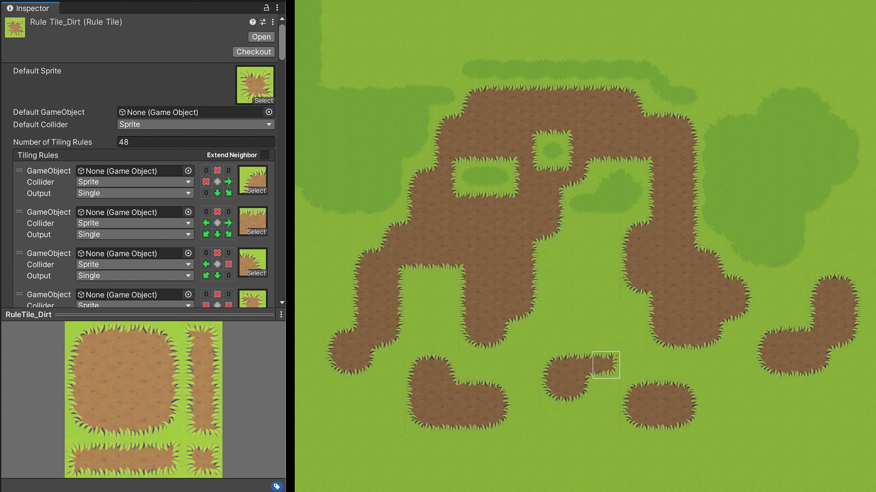
WEEK 8
The Tile Palette
The Tile Palette is Unity's visual tool for painting tiles onto your Tilemap. It functions like an artist's palette — select tiles and paint them directly into the Scene view.
KEY TOOLS
■ Paint ■ Box Fill ■ Pick ■ Erase ■ Flood Fill
■ Organize tiles into categories
■ Drag-and-drop sprite sheets
Access: Window > 2D > Tile Palette | Support for multiple palettes per project
Pro Tip: Use keyboard shortcuts to switch between tools quickly. Hold Shift while painting to draw straight lines, and Ctrl/Cmd to temporarily switch to the Pick tool.
06

Slide 7
WEEK 8
Creating Your First Tile Palette
1
Prepare sprites — Slice your sprite sheet in the Sprite Editor with proper grid settings
Best Practices
2
Create a Grid — GameObject > 2D Object > Tilemap to set up your level container
■ Organize by type — separate palettes for ground, walls, and decorations
■ Name your tiles — descriptive names save time when scripting
■ Use consistent grid sizes — match tile size to your game's pixel-per-unit
■ Lock palettes — prevent accidental edits to finished tile sets
■ Version control — palettes are assets; commit them with your project
3
Open Tile Palette — Create a New Palette and save it to your project
4
Drag sprites — Drop sliced sprites from Project window into the Tile Palette
5
Start painting — Select the Paint tool and draw on your Tilemap in the Scene view
07

Slide 8
WEEK 8
Working with Tiles
Unity provides several tile types for different level design needs.
BASIC
SMART
DYNAMIC
Standard Tile
Rule Tile
Animated Tile
Basic sprite-based tile with simple properties. The foundation for all other tile types.
Automatically selects sprites based on neighboring tiles. Saves hours of manual placement.
Cycles through multiple sprites over time. Perfect for water, fire, and environmental effects.
CONNECT
BLEND
Pipeline Tile
Terrain Tile
Connects tiles based on adjacency rules. Ideal for roads, pipes, and wire systems.
Blends between different terrain types. Creates smooth transitions between grass, dirt, and sand.
08

Slide 9
WEEK 8
Rule Tiles — Smart Tiling
Rule Tiles are one of the most powerful features of the Tilemap system. They automatically choose the correct sprite variant based on neighboring tiles.
Instead of manually selecting corner pieces, edge pieces, and center pieces, Rule Tiles handle this automatically.
This dramatically speeds up level creation and ensures visual consistency across your entire map.
HOW IT WORKS
1. Each Tiling Rule checks neighboring positions: North, South, East, West, and diagonals
2. Neighbor conditions: This (same tile), Not This (different tile), or Don't Care (any tile)
3. When conditions match, the rule outputs its assigned sprite to that position
4. Rules are evaluated top to bottom — place most specific rules first
09

Slide 10
WEEK 8
Configuring Rule Tiles
TILING RULES
TIPS FOR SUCCESS
Default Sprite — the fallback sprite used when no rules match the current neighbor configuration
■ Start specific
Place your most specific rules at the top of the list. Generic fallback rules should be last.
■ Use Rule Override Tile
Create visual variations (snowy grass, dry grass) without duplicating rule logic.
■ Test with complex shapes
Paint circles, diagonals, and irregular patterns to ensure your rules cover all edge cases.
Tiling Rules List — each rule specifies neighbor conditions and the output sprite to use
Neighbor Conditions — This, Not This, or Don't Care for each surrounding position
Rule Output Modes — Single sprite, Random selection, or Animation sequence
10

Slide 11
WEEK 8
Animated Tiles
Animated Tiles bring life to your Tilemap by cycling through a sequence of sprites over time. They are perfect for creating dynamic environmental effects without requiring individual GameObjects.
COMMON USE CASES
Flowing Water
Flickering Torches
Swaying Grass
Sparkling Loot
Magic Effects
Rivers, oceans, waterfalls
Candles, campfires, lamps
Vegetation, leaves, vines
Treasure, crystals, power-ups
Portals, runes, auras
Performance advantage: Animated Tiles are handled by the Tilemap renderer, not individual Animation components — much more efficient for large environments.
11

Slide 12
WEEK 8
Creating Animated Tiles
1
Create the asset — Assets > Create > Tiles > Animated Tile
Pro Tips
2
Assign sprites — Add your animation frames to the sprite array in order
■ Use the same Start Time for all tiles of the same type to keep animations perfectly synchronized
■ Vary Start Time across tiles for a more natural, organic feel (great for grass and water)
■ Keep sprite counts low (2-4 frames) for optimal Tilemap rendering performance
■ Combine with Rule Tiles for animated edges and borders
3
Set speed — Configure Min and Max animation speed values
4
Set start time — Control animation synchronization across tiles
5
Paint — Use the Animated Tile on your Tilemap like any other tile
12

Slide 13
WEEK 8
Lecture 15 — Key Takeaways
1
Tilemaps provide a grid-based system for efficient 2D level construction with automatic batching and physics integration.
2
The Tile Palette is your primary painting tool — organize tiles, switch between tools, and paint directly in the Scene view.
3
Rule Tiles automate sprite selection based on neighbor conditions — no more manual corner and edge placement.
4
Animated Tiles add dynamic visual effects to static Tilemaps efficiently through the Tilemap renderer.
Together, these tools form a powerful workflow for rapid 2D level prototyping and production — from concept to playable level in minutes.
Up next: Lecture 16 — Player Setup, Input System, Canvases & Level Design
13

Slide 14

02
LECTURE 16
Player Setup, Input System, Canvases & Level Design
■ Combining Rules & Animation ■ Player Physics & Input
■ Canvases & UI Components ■ Level Setup & Design

Slide 15
WEEK 8
Combining Rules and Animation
Animated Rule Tiles combine the power of both systems — Rule Tiles that output animated sequences instead of static sprites. This enables complex, adaptive visual behaviors.
PRACTICAL EXAMPLES
Adaptive Water
Wall Torches
Border Grass
Animated water that adapts its edge sprites based on surrounding terrain — shorelines, corners, and deep water all flow differently.
Flickering torches that automatically detect wall edges and orient their flames correctly — no manual placement needed.
Grass that sways differently at borders versus centers — creating a natural, organic feel across your entire level.
Setup: In your Rule Tile, set the Output type to Animation instead of Single. Then assign your sprite sequence to that rule.
15

Slide 16
WEEK 8
Player Setup Overview
Setting up a playable character involves three core systems working together to create responsive, physics-driven gameplay.
Physics
Input
Visual
■ Rigidbody2D
■ Collider2D
■ Physics Material 2D
Movement, collision detection, and physical interaction with the world.
■ Input Actions
■ Action Maps
■ Player Input
Handling player controls from keyboard, mouse, gamepad, and touch.
■ Sprite Renderer
■ Animator
■ Animation Clips
Character appearance, animations, and visual feedback for actions.
16

Slide 17
WEEK 8
Physics — Rigidbody2D
The Rigidbody2D component is the heart of 2D physics in Unity. Here are the key properties for platformer characters:
Best Practice
Property | Description & Recommendation
Body Type | Dynamic for physics-driven, Kinematic for script-driven
Gravity Scale | Adjust for weight feel — 1-3 for platformers
Constraints | Freeze Z rotation to prevent tipping over
Interpolation | Interpolate for smoother visual movement
Collision Detection | Continuous for fast-moving characters
■ Use Dynamic body type for player characters — let physics handle gravity and collisions naturally.
■ Adjust Gravity Scale to fine-tune jump feel. Higher values = heavier, faster falls.
■ Always freeze Z rotation unless you specifically want your character to tumble.
■ Use Interpolate to eliminate jittery movement at low physics tick rates.
■ Set Collision Detection to Continuous to prevent tunneling through thin platforms at high speeds.
17

Slide 18
WEEK 8
Physics — Colliders
Collider2D components define the physical shape of your player for collision detection.
Box Collider 2D
Circle Collider 2D
Capsule Collider 2D
Composite Collider
Best for rectangular characters. Most performant option. Good for platformers with blocky sprites.
Best for round characters or rolling mechanics. Smooth collision response on slopes and curved surfaces.
Ideal for humanoid characters. Combines flat bottom (stable standing) with rounded top (smooth ceiling collisions).
Combines multiple colliders into one shape. Used with Tilemap Collider 2D to merge adjacent tile collisions.
IMPORTANT SETTINGS
■ Is Trigger — overlap detection without physical response ■ Material — Physics Material 2D for friction/bounciness ■ Offset/Size — fine-tune to match sprite bounds
18

Slide 19
WEEK 8
Input System Overview
Unity's Input System is a modern, flexible framework for handling player input. It replaces the legacy Input Manager with a more robust, event-driven approach supporting keyboard, mouse, gamepad, and touch.
KEY CONCEPTS
Input Actions
Action Maps
Define what inputs the game responds to — Move, Jump, Attack, Interact
Group related actions — "Gameplay" map, "Menu" map, "Vehicle" map
Input Bindings
Player Input
Connect actions to specific keys, buttons, or axes — WASD, Space, Gamepad A
Component that bridges the Input System with your game scripts
Unified API: The Input System provides one consistent interface for all input devices — keyboard, mouse, gamepad, and touch — with automatic device detection and remapping support.
19

Slide 20
WEEK 8
Input Actions & Action Maps
1
Create asset — Assets > Create > Input Actions
Action Maps Explained
2
Define Action Maps — "Player" for gameplay, "UI" for menus
■ Gameplay Map
Active during play — Move, Jump, Attack, Pause
■ Menu Map
Active in menus — Navigate, Select, Back
■ Context Switching
Enable/disable maps at runtime for context-sensitive controls
3
Add Actions — Move, Jump, Attack, Interact
4
Configure Bindings — WASD/Arrows for Move, Space for Jump
5
Generate C# class — for type-safe code access
6
Add Player Input — component to your player GameObject
20

Slide 21
WEEK 8
Player Controller Script
The Player Controller bridges Input System events with Rigidbody2D physics. The golden rule: separate input reading from physics application.
CORE PATTERN
UPDATE
FIXEDUPDATE
RESULT
Read input values here:
movement direction, jump pressed
Apply physics here:
rb.velocity or AddForce()
Smooth, responsive
physics-driven movement
KEY METHODS
OnMove(InputValue value) — called when movement input changes, read value.Get<Vector2>()
OnJump() — called when jump action is triggered, apply upward force to Rigidbody2D
FixedUpdate() — apply physics here using stored input values, never read input directly in FixedUpdate
21

Slide 22
WEEK 8
Canvases and User Interface
The Canvas is Unity's foundational UI component — all UI elements must be children of a Canvas. Proper configuration ensures your UI looks great across all screen sizes.
ESSENTIAL PROPERTIES
Render Mode
Canvas Scaler
Graphic Raycaster
Overlay for HUD, Camera for perspective, World Space for in-world UI like nameplates
Controls how UI adapts to different resolutions. Use Scale With Screen Size for consistent sizing.
Handles click and touch detection on UI elements. Required for Buttons, Sliders, and interactive UI.
Best Practice: Set your Canvas Scaler reference resolution to your target design resolution (e.g., 1920x1080) and use Scale With Screen Size mode for consistent UI across devices.
22

Slide 23
WEEK 8
UI Components
Unity provides a rich set of built-in UI components for building game interfaces.
Text / TextMeshPro
Image
Button
Slider
Display text with crisp, scalable rendering
Display sprites, textures, and backgrounds
Clickable elements with Normal, Hover, Press states
Health bars, progress indicators, volume controls
Toggle
Dropdown
Input Field
Scroll View
On/off switches for settings and options
Selection menus for resolution, quality, etc.
Text entry for player names, chat, search
Scrollable content panels for inventories, lists
LAYOUT COMPONENTS
Horizontal/Vertical Layout Group — automatic arrangement | Content Size Fitter — auto-resize to content | Aspect Ratio Fitter — maintain proportions
23

Slide 24
WEEK 8
Canvas Render Modes
Understanding Canvas Render Modes is critical for proper UI implementation in different contexts.
MOST COMMON
EFFECTS
WORLD
Screen Space — Overlay
Screen Space — Camera
World Space
UI renders on top of everything in the scene. The simplest mode for HUDs, menus, and overlays.
■ No camera needed
■ Always on top
■ Best for: health bars, score, pause menus
UI placed at a fixed distance from a specified camera. Supports perspective and lighting effects.
■ Requires camera reference
■ Supports 3D rotation
■ Best for: cinematic UIs, 3D menus
UI exists in the 3D world like any other GameObject. Perfect for in-world interactive elements.
■ Full 3D positioning
■ Can be occluded by world geometry
■ Best for: nameplates, signs, diegetic UI
24

Slide 25
WEEK 8
Level Setup
Bringing it all together: a complete level combines Tilemaps, Player, Camera, UI, and Environmental objects into a playable experience.
SETUP WORKFLOW
1
Design Layout
2
Add Collisions
3
Place Player
4
Configure Camera
Paint the environment with Tilemaps
Tilemap Collider 2D for walkable surfaces
Set the player start position
Cinemachine or custom follow script
5
Add Gameplay Objects
6
Implement UI Overlay
Collectibles, hazards, enemies, triggers
Health, score, menus on Canvas
LEVEL COMPONENTS
Tilemaps | Player | Camera | UI | Environment
Visuals + Collision | Physics + Input | Follow + Bounds | HUD + Menus | Objects + Triggers
25

Slide 26
WEEK 8
Level Design Best Practices
Visual Hierarchy
Collision Clarity
Flow and Pacing
Use tile layers to create depth — background, midground, and foreground layers guide the player's eye and create parallax.
Ensure walkable surfaces are visually distinct from background decoration. Players should instantly know what's solid.
Guide players with tile arrangement and lighting. Alternate challenge and rest areas for engaging pacing.
Performance
Iteration
Use Tilemap chunk optimization and limit the number of animated tiles. Profile early and often.
Use Rule Tiles to rapidly prototype and modify layouts. Test, iterate, and refine your designs quickly.
26
"Good level design teaches the player through play, not text."

Slide 27
WEEK 8 COMPLETE
YOU'RE READY TO BUILD
You now have the tools to build complete 2D levels — from tile-based environments
to playable characters with physics and input.
Next week: Enemies, Collectibles, and Game Mechanics

